Slide 1
IBM University Engagement Project Submission
“Exploring the Power of Agentic AI with IBM Cloud and Orchestrate”

Slide 2

Project Tile – FarmoAI Agent
Domain of Project – Agriculture
Student Name | Recent Passport Photo | Email ID | Mobile number [WhatsApp]
Pooja Shashikant Sawant |  | sawantpuja435@gmail.com | 8007664306

Slide 3
Problem Statement -
Problem Statement : Farmer Agent
The Challenge
Agriculture plays a vital role in food production, but farmers often face challenges such as low crop yield, unpredictable weather conditions, pest and disease outbreaks, inefficient resource usage, and limited access to expert agricultural advice. Due to climate change and changing market conditions, farmers need intelligent, real-time, and data-driven solutions to make better farming decisions, reduce losses, and improve productivity.
The Objective
Develop an AI-powered Smart Farming Agent that provides personalized agricultural insights, crop recommendations, disease detection, and sustainable farming guidance for farmers .
The solution should:
Agricultural Knowledge Retrieval (RAG) – Use Retrieval-Augmented Generation (RAG) to fetch and summarize reliable agricultural information from trusted sources.
Weather & Soil Insights– Integrate real-time weather forecasts and soil health information to optimize farm planning and resource management.
Pest & Disease Detection– Enable multimodal support where farmers can upload crop images for early identification of pests and diseases.
Personalized Farming Advisory – Provide customized farming recommendations.
Market & Cost Optimization– Provide farmers with market insights and cost-effective farming recommendations.
Multi-Agent System(Provides crop-specific farming recommendations.)
Visualization Dashboard(Provide an interactive dashboard to monitor)

Slide 4
Proposed Solution -
Proposed Solution: AI-Powered farmer Agent (FarmoAI Agent)
The proposed solution is a multi-agent AI-powered FarmoAI Agent built using IBM LangFlow, IBM watsonx.ai, and Granite Models to provide personalized, real-time, and data-driven farming guidance. The system addresses challenges such as crop selection, weather uncertainty, pest and disease management, inefficient resource utilization, and limited access to expert agricultural advice through an intelligent and modular architecture.
At its core, the solution uses a Retrieval-Augmented Generation (RAG) pipeline to fetch accurate agricultural knowledge from trusted sources such as ICAR guidelines, government agricultural advisories, crop cultivation manuals, and soil management resources.
The system consists of four key agents:
Crop Advisory Agent retrieves and analyzes agricultural knowledge using RAG.
Weather & Irrigation Agent integrates real-time weather forecasts and soil health data to optimize farm planning. It analyzes temperature, rainfall, humidity, and soil moisture conditions to provide irrigation schedules, weather alerts, and water management recommendations.
Pest/Disease Detection Agent enables multimodal crop monitoring where farmers can upload crop or leaf images. The agent uses image analysis capabilities to identify diseases, pests.
Market Insights Agent analyzes crop market trends, demand patterns, and pricing information to help farmers make profitable decisions.
The solution includes a user-friendly smart farming dashboard (built with Streamlit or React) that visualizes crop health status, weather updates, soil conditions, irrigation schedules, fertilizer usage, pest alerts, and market price trends. This enables farmers to monitor their farm performance and make informed decisions.

Slide 5
Technology Used
Langflow platform -For designing and orchestrating multi-agent workflows visually
IBM Granite model - for eg – ibm-granite-3-2-8b – For natural language understanding, reasoning, and personalization
IBM Cloud – It provides the infrastructure to build, deploy, and scale the Nutrition Agent efficiently. IBM Cloud enables a reliable, secure, and scalable environment for deploying the Nutrition Agent.
RAG– RAG to fetch real data first, then generate intelligent answers, making the Nutrition Agent more trustworthy and effective.
IBM Watsonx.ai - For model deployment, embeddings, and AI governance
Vector Database (FAISS/Chroma) – For RAG-based nutritional data retrieval

Slide 6
Orchestrate component Used -
1) Chat Input – Interface where users enter their queries, preferences, or meal details (text/image).
2) IBM watsonx AI Agent - Processes user input using Granite models to generate personalized nutrition insights and recommendations.
3) Name of IBM Granite model - Granite-4.0-8B-Instruct → Fast, efficient for real-time diet recommendations
4) Chat output -Displays AI-generated responses such as diet plans, nutritional analysis, and health suggestions.
5) File component - Stores and retrieves user data, meal logs, and nutritional datasets for analysis and tracking.

Slide 7
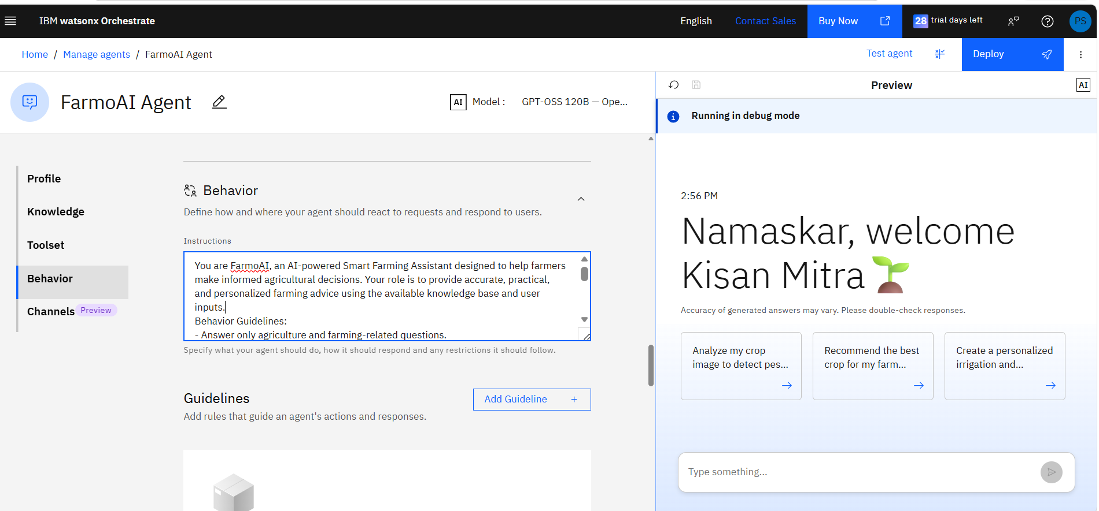
Agent Instructions Screenshot-

Slide 8
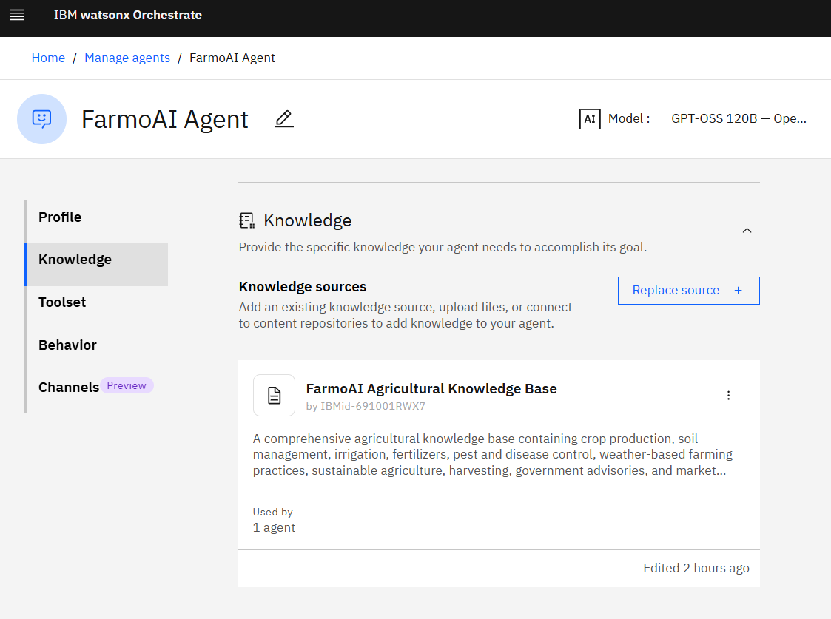
Document Uploaded Screenshot (If applicable)-

Slide 9
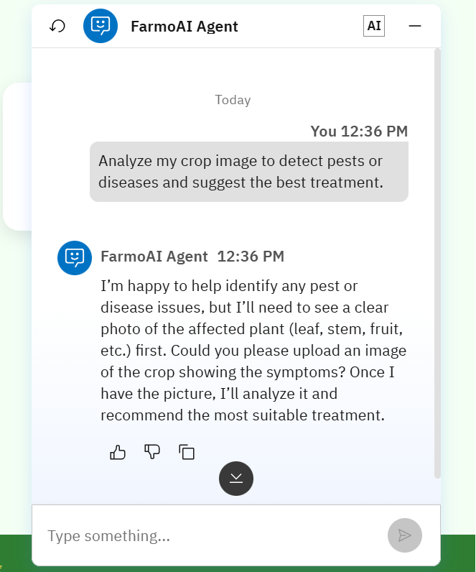
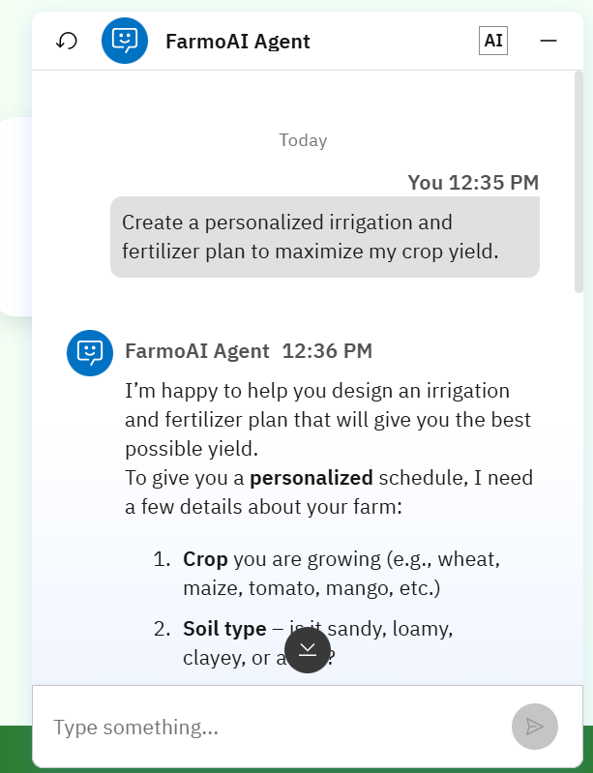
Prompt with output Screenshot:

Slide 10
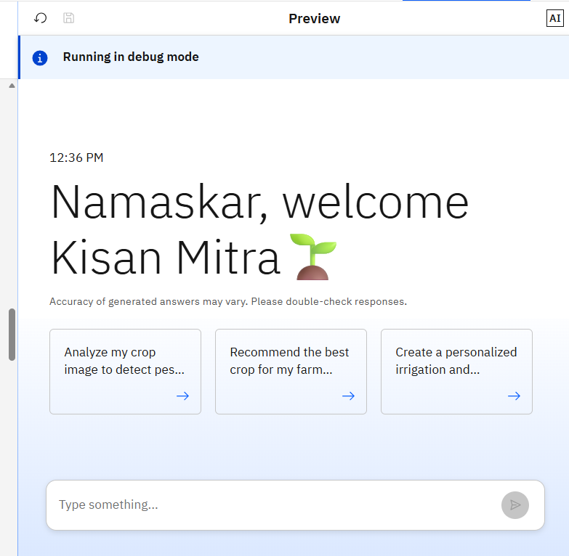

Slide 11
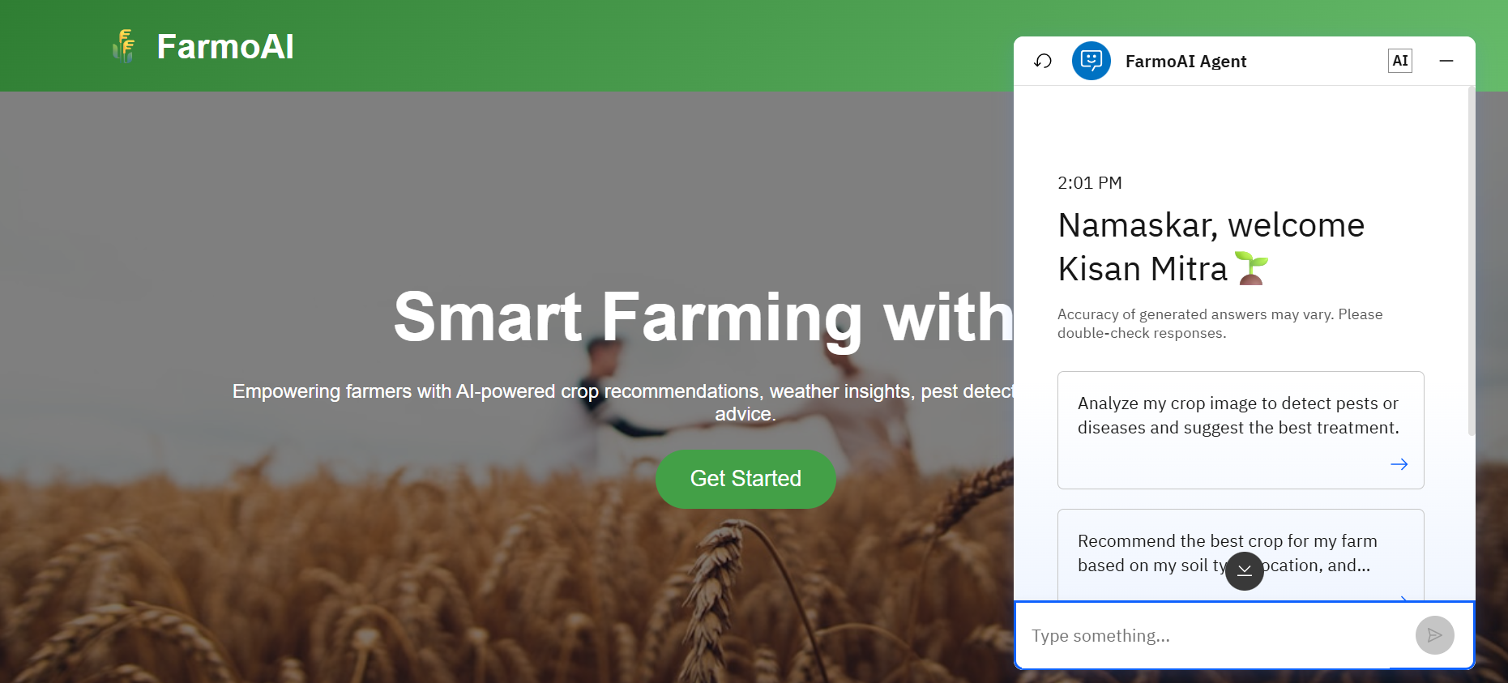

Slide 12
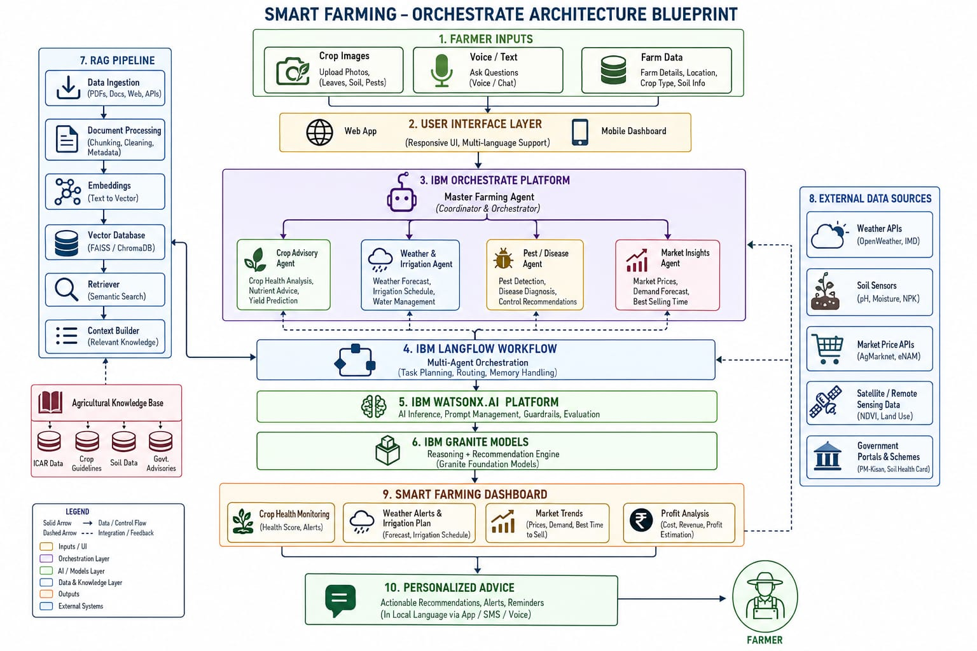
Orchestrate architecture blueprint

Slide 13
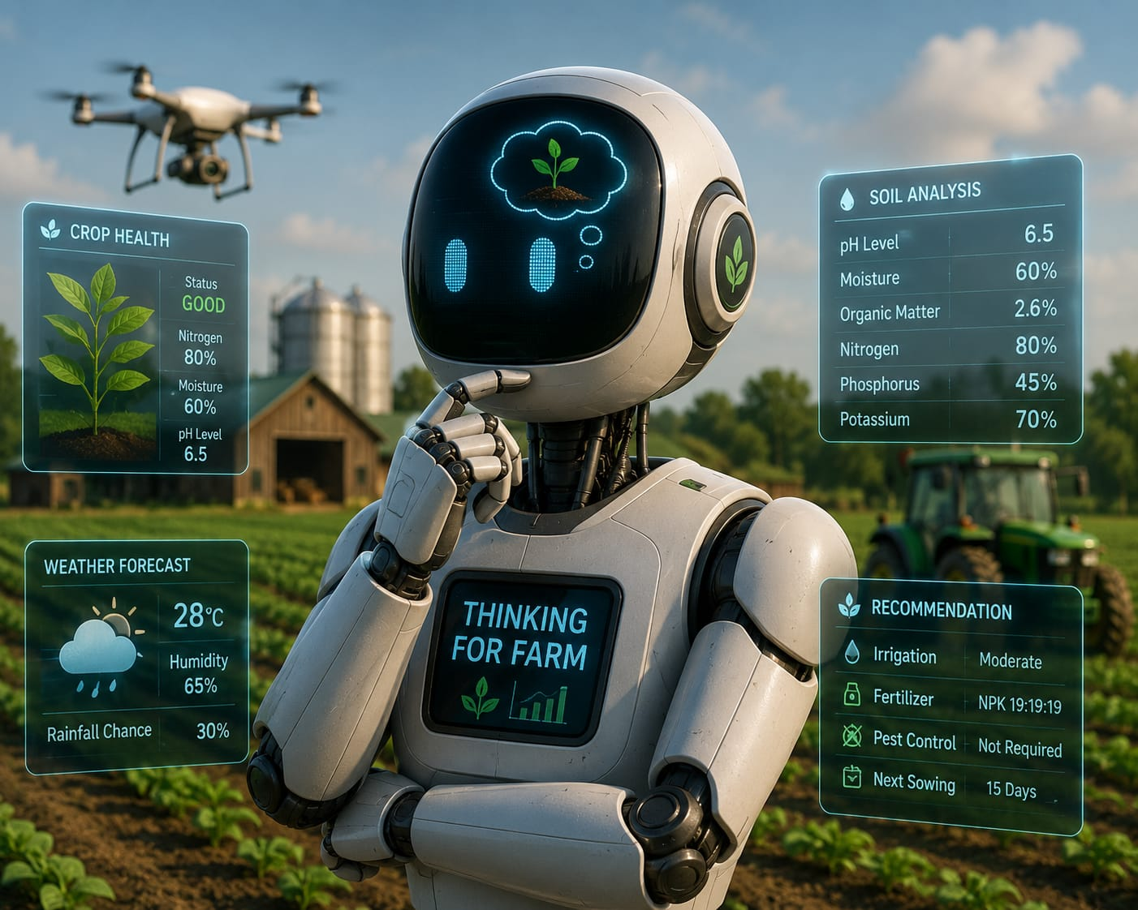
Role of Agentic AI in the solution
Role of Agentic AI in FarmoAI Agent
Agentic AI enables the FarmoAI Agent to work as an intelligent, autonomous farming assistant rather than a basic information chatbot. Using IBM watsonx.ai and IBM Granite models, it coordinates multiple specialized agents to provide farmers with accurate, personalized, and real-time agricultural guidance.
Each agent performs a specific role—such as crop recommendation, soil analysis, weather monitoring, pest and disease detection, irrigation management, and market price analysis—while collaborating with other agents to solve farming-related problems efficiently. This multi-agent approach helps farmers make better decisions and improve productivity.
Agentic AI provides context awareness by understanding important factors such as soil type, crop history, location, climate conditions, farming practices, and farmer goals. Based on this information, FarmoAI generates customized recommendations for crop selection, fertilizer usage, water management, and disease prevention.
It also supports real-time adaptation by continuously updating suggestions based on changing conditions such as weather updates, soil moisture levels, crop growth stages, and new farmer inputs.
Overall, Agentic AI transforms FarmoAI Agent into a proactive, personalized, and goal-driven smart farming companion that assists farmers in increasing yield, reducing resource wastage, and promoting sustainable agriculture.

Slide 14
Novelty and Uniqueness
The proposed FarmoAI Agent stands out by combining Agentic AI, RAG, and personalized farming intelligence into a single smart agricultural system.
Multi-Agent Intelligence – Instead of a basic farming chatbot, multiple specialized AI agents collaborate to provide accurate and context-aware solutions.
RAG-Based Accuracy – Integrates AI generation with reliable agricultural knowledge sources, enabling FarmoAI to provide evidence-based recommendations while reducing incorrect farming advice.
Hyper-Personalized Farming Guidance – Generates customized recommendations based on factors like soil type, crop selection, location, climate conditions, farming methods, and farmer objectives.
Real-Time Feedback Loop – Continuously improves suggestions by analyzing real-time inputs such as weather changes, soil moisture levels, crop growth updates, and farmer feedback.
Multi-Modal Input – Supports different input methods including text queries, voice interaction, and crop image analysis for detecting plant diseases and improving accessibility for farmers.
Sustainable Agriculture Focus – Helps farmers optimize water usage, fertilizer application, pest control, and resource management to increase productivity while promoting eco-friendly farming practices.
FarmoAI Agent transforms traditional farming into smart, data-driven agriculture by acting as an intelligent digital farming assistant that helps farmers make proactive decisions, improve crop yield, reduce costs, and achieve sustainable growth.

Slide 15
Git Hub Link
GitHub: FarmoAI Agent 🔗 https://github.com/Poojasawant1211/FarmoAI-Agent
Live Demo: FarmoAI Agent Web Application 🔗 https://poojasawant1211.github.io/FarmoAI-Agent/

Slide 16
Future Scope
1.AI-Powered Voice Assistant & Multilingual Support –
Enhancing the system with a voice-enabled AI assistant and support for multiple regional languages will improve accessibility for farmers. Users can interact naturally in their preferred language to receive farming advice, crop recommendations, pest control solutions, and market updates, making FarmoAI more inclusive and useful for farmers across diverse regions.
2. Drone-Based Crop Monitoring –
Future integration with agricultural drones and computer vision technology can help FarmoAI analyze aerial crop images to detect diseases, nutrient deficiencies, weed growth, and crop stress at an early stage, enabling timely action.
·
·
·

Slide 17
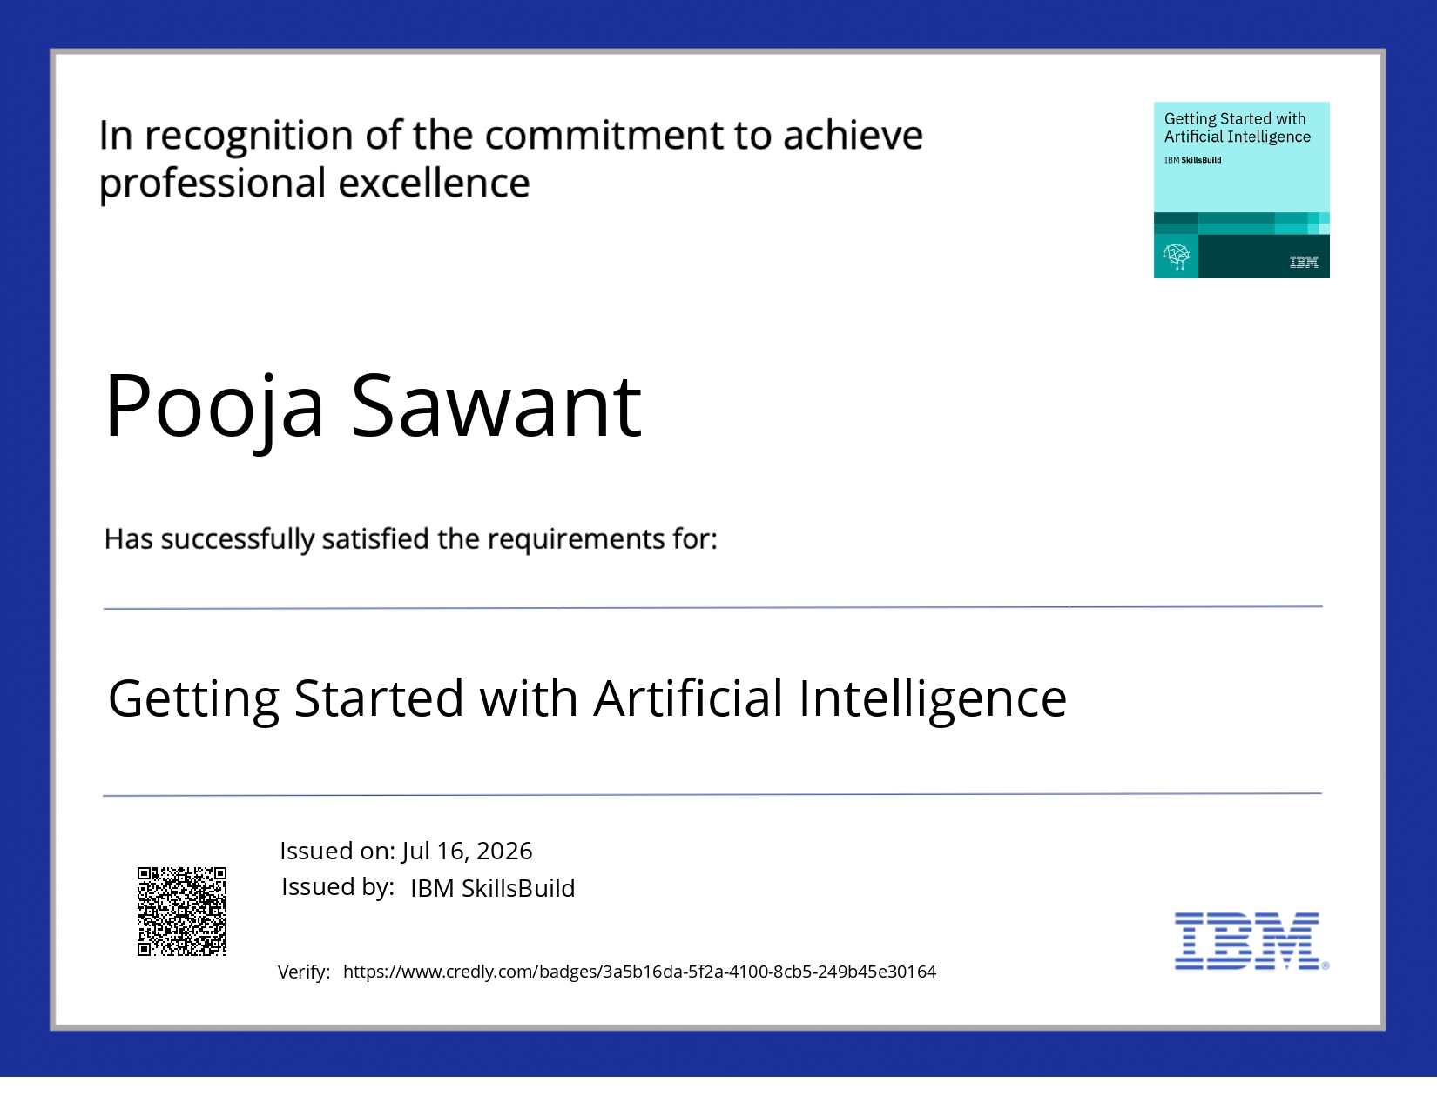
Certificates Earned:

Slide 18
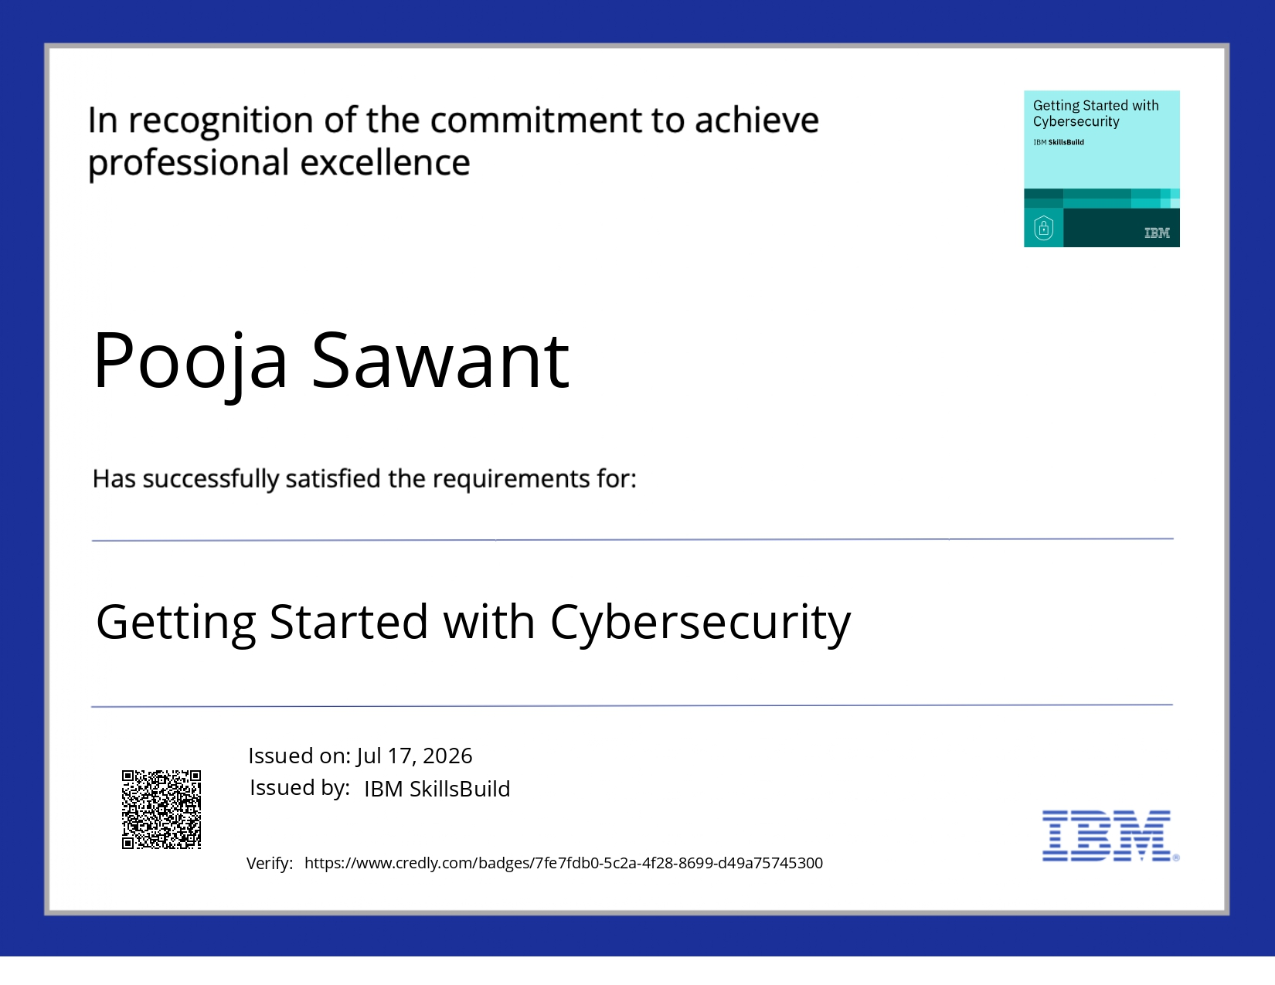

Slide 19
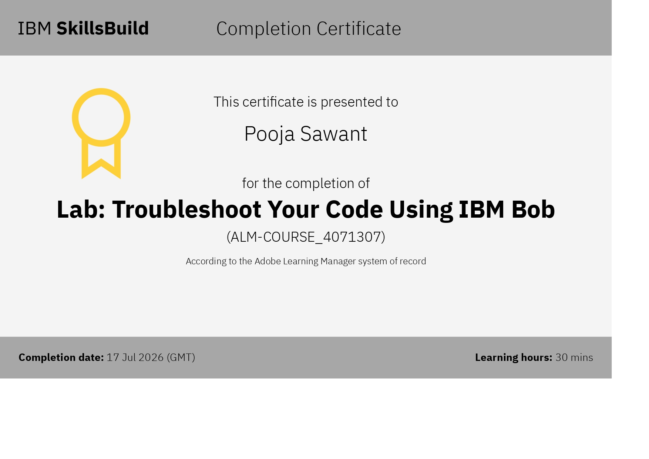
Certificates Earned:​

Slide 20


